Slide 1

Trinity Solutions is proud to offer TACKLERS Material Handling Equipment

Slide 2


Company Overview
Established in the year 1979.
“TACKLERS” brand.
Manufacturer, Supplier & Exporter of Materials Handling Equipment.
ISO 9001:2015 Certified Company.
Our Installations:
Cranes – More than 1700 Nos.
Hoists – More than 5500 Nos.

Slide 3







Our Journey
Unit-I, Manufacturing
facility @ Vatva GIDC with the area of 2600 Sq. Meters .
First 100 Ton Crane
Designed & Installed
For Heavy Engineering.
Sales & Services
network started.
Entering partnership
with STAHL Crane Systems GmbH, Germany
1979
1984
2005
2009
2010
2011
2013
2014
2018
A visionary person Mr. Atul Chokshi started the company in the field of Materials Handling Equipment manufacturing Manual Chain Pulley Blocks under the name of “TECHNO INDUSTRIES”.
Registered
brand with the name of “TACKLERS”
First 125/25 Ton Crane Design & Installed For Engineering Application.
Unit – II,
manufacturing setup with 300 Ton load testing facility @ Piplaj, Ahmedabad with the area of 9000 Sq. Me
Started Floor Handling Equipments. Products Range:
Pallet Truck, Stackers, Forklifts

Slide 4
Our Products
Techno Industries’ products are sold under popular & most reliable brand, “TACKLERS”. These products are also designed and manufactured as per international standards. The range & type of TACKLERS products are briefly listed below :
EOT Cranes ranging from 500 kg to 300 Ton lifting capacity*
Goliath/Gantry Cranes ranging from 500 kg to 200 Ton lifting capacity*
H.O.T Cranes & Manual Chain Pulley Blocks ranging from 1 Ton to 25 Ton capacity.
Wall Mounted & Pillar Mounted Jib Cranes, Semi-Gantry Cranes, Under Slung Cranes, Circular Cranes & Hoists, etc.
Wire Rope Hoists from 0.25 Ton to 50 Tons.
Electric Chain Hoists from 0.25 Ton to 3 Tons.
Floor Operated Transfer Trolley to move heavy loads up to 300 Tons.
Crane Kits & Crane Accessories
* Higher lifting capacity available

Slide 5
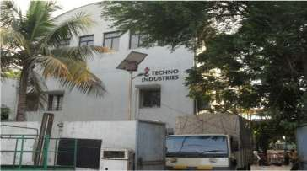
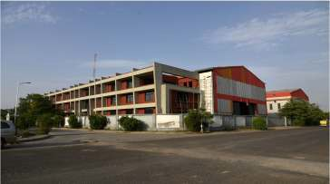
Manufacturing Plants
Unit-I
Area of 2600 Sq. Meters.
Manufacturing setup for Hoists, Crane KITS & Components.
Production Capacity: 700 Nos. / year.
Unit-II
Area of 9000 Sq. Meters.
Manufacturing setup for all Cranes.
Production Capacity: 300 Nos. / year.

Slide 6
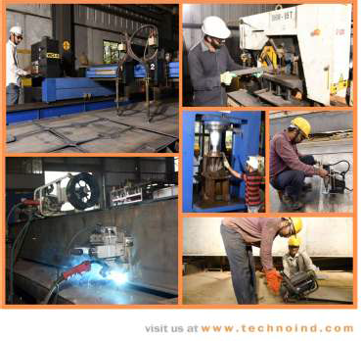
Manufacturing Machinery
Manufacturing Machinery:
CNC Plasma Cutting Machine.
Automatic Welding Machine.
Beveling Machine for edge preparation.
Lathe Machines.
Hydraulic Press Machine.
Overhead EOT Cranes up to 30 Ton.

Slide 7
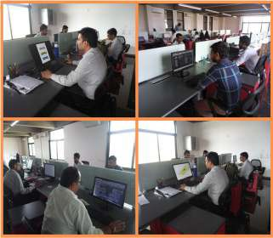
Our Strength
Design Team:
10+ Years experienced design team (Electrical & Mechanical)
Design Software: Auto Desk, Solid Works.
Analysis Software: STAAD PRO, ANSYS.
Sales & Service Network:
Offer Management Team: 5+
Sales & Marketing Team: 10+
Spares & Service Team: 15+

Slide 8
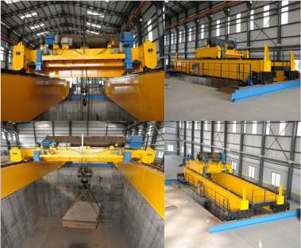
In house Testing
For Cranes - Load pit with 300 Ton Capacity
(Pit size: - 9 meter height x 7 meter width x 12 meter length).
For Hoists – Testing bench with 50 Ton Capacity.
Complete inspection and testing as per IS Standard.
Having Special Crab and crane span setting benches.
100 Ton MS Slabs available which are to be lifted with special lifting beam.
Separate panel wherein one can witness no load, full load amps, crane deflection, speed measurement etc.
Having facility to witness crane testing & load test from different location through a camera installed in pit.

Slide 9




Techno Industries has Associated with STAHL Crane Systems, Germany for Crane Components.
At a glance:
Established in 1876; The experience of over 135 Years of Cranes.
STAHL Crane ranks among the leading Manufacturing of Crane components on an International level.
Having manufacturing plant in Germany or Worldwide Branch Offices.
Products comes with Origin Certificate.

Slide 10
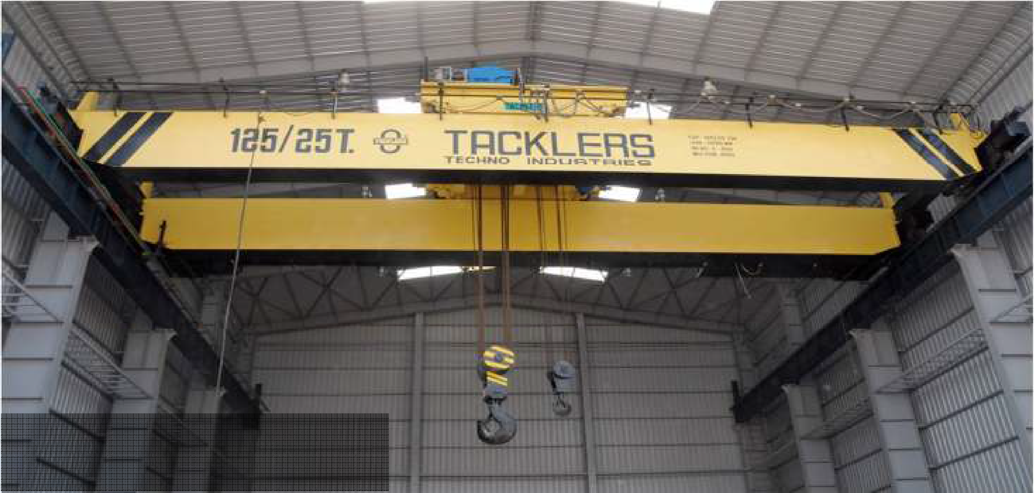
Installations
Indo Air Compressors, Ahmedabad
125/25 Ton Double Girder EOT Crane

Slide 11
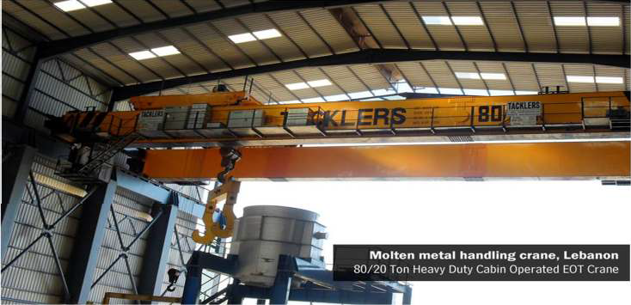
Installations
MEIL – Hydro Power & Dams, Bhuj
100/10 Ton Double Girder EOT Crane

Slide 12
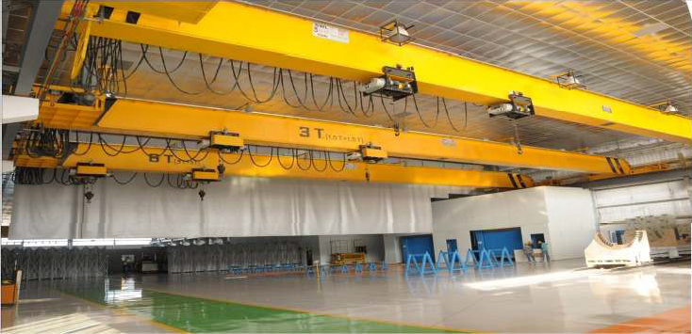

Installations
L&T – MHI Turbine Generators Pvt. Ltd.
3T + 3T Single Girder EOT Crane
Span 31.8 Mtrs.

Slide 13
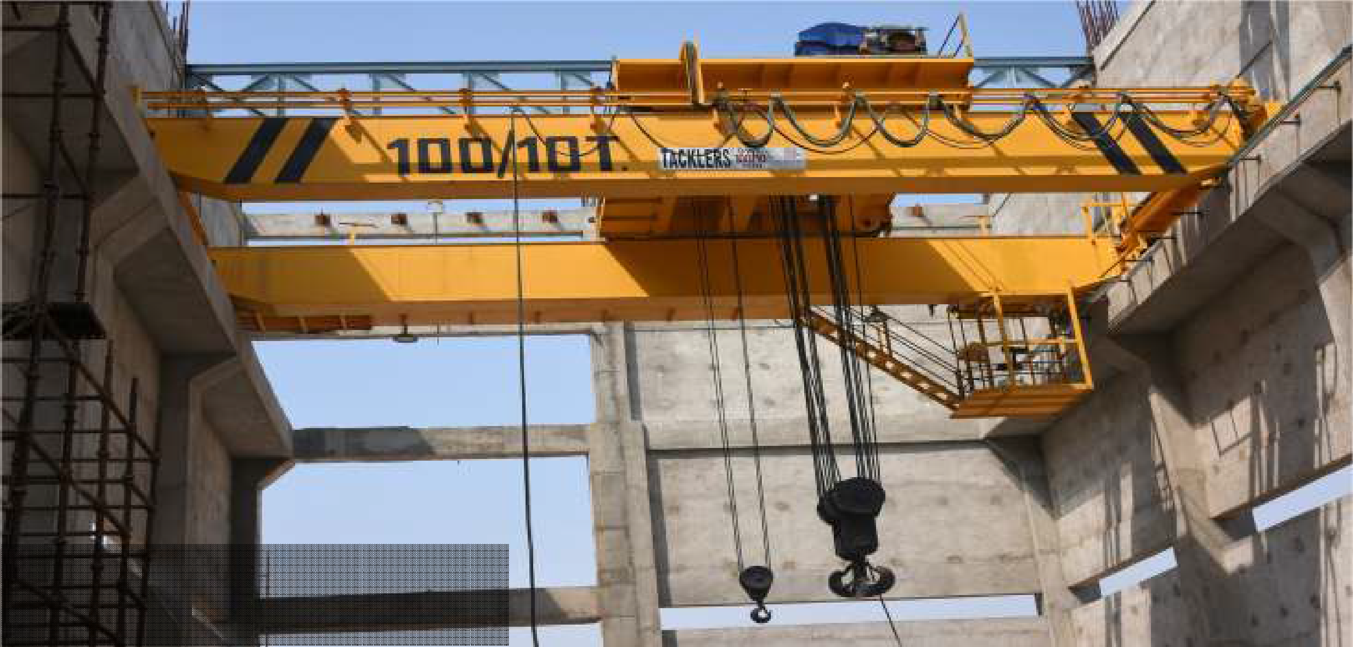
Installations
MEIL – Hydro Power & Dams, Bhuj
100/10 Ton Double Girder EOT Crane

Slide 14
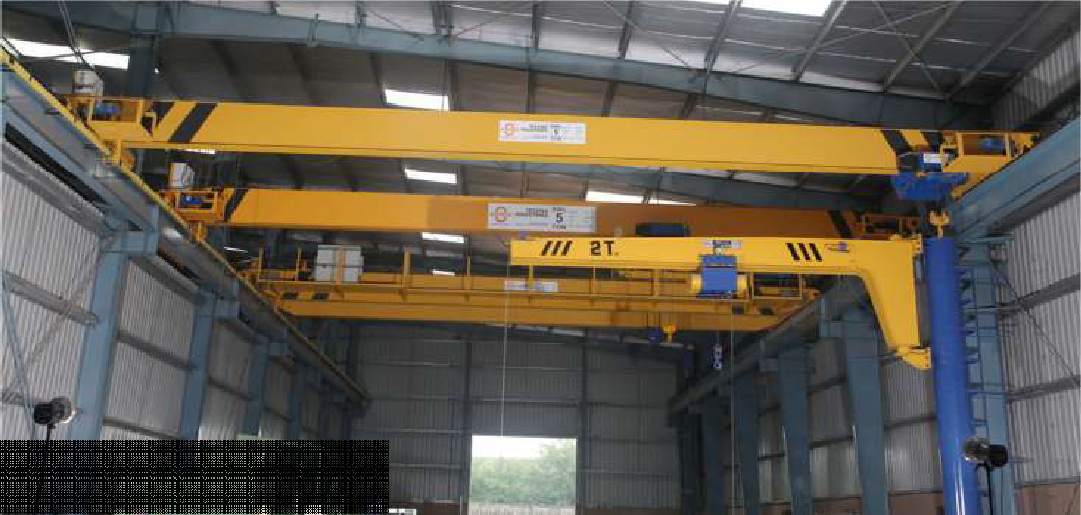
Installations
Futura Engineering Pvt. Ltd.
Various capacities cranes up to 10 Ton.

Slide 15
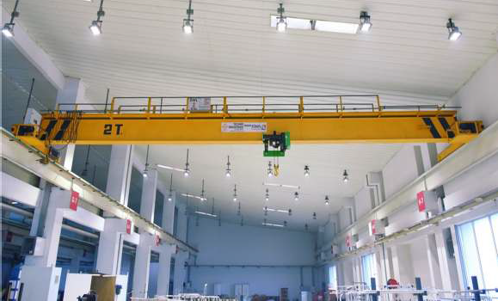
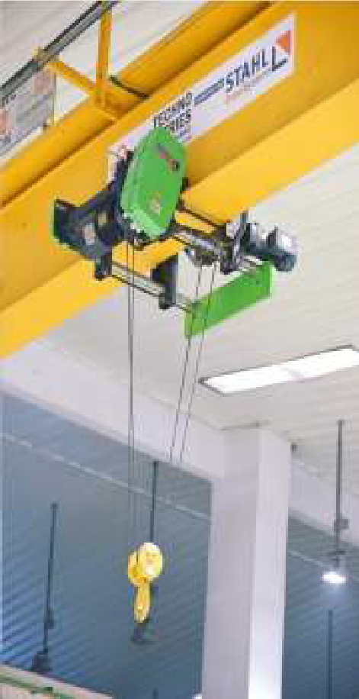

Installations
Milacron India Pvt Ltd - Ahmedabad
2 T Single Girder EOT Crane + STAHL Hoist

Slide 16
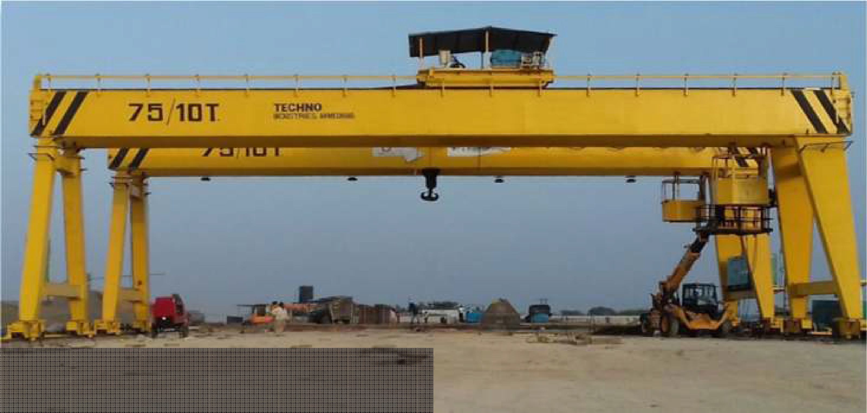
Installations
GR Infrastructure Ltd. – Pre Cast Gantry Crane
75/10 Ton Gantry Crane x 2 Nos.

Slide 17
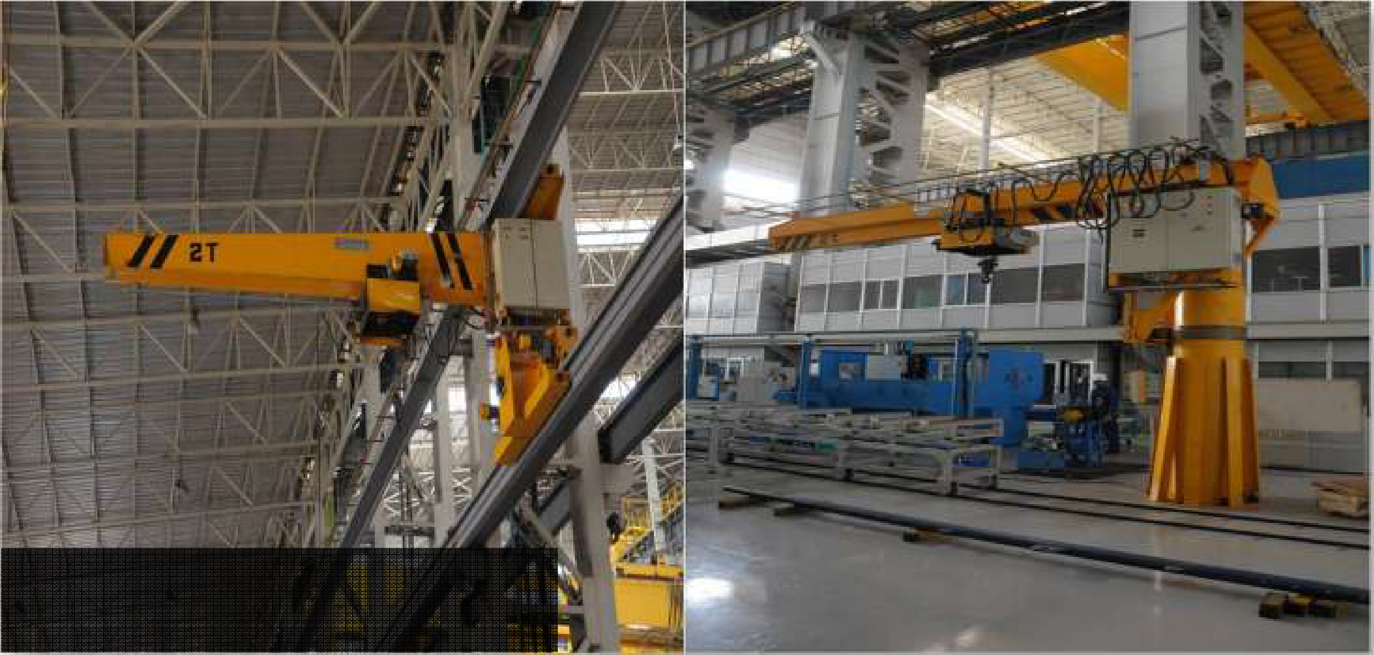
Installations
L&T – MHI Turbine Generators Pvt. Ltd.
2T Wall Traveling + Pillar Mounted Jib Crane

Slide 18
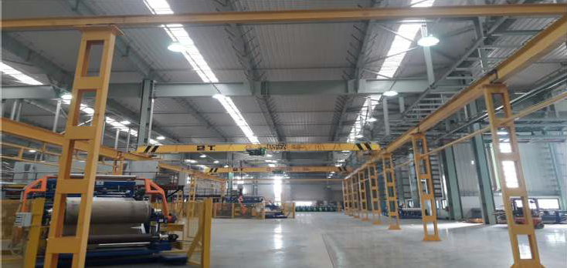

MRF
Installations
MRF Tyre – Dahej
2T Single Girder EOT Crane
Free Standing Structure

Slide 19
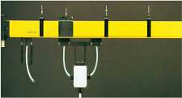
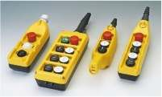
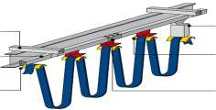
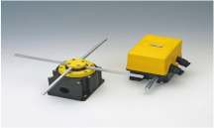
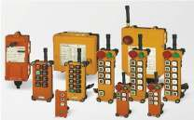
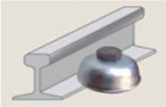
Crane Accessories
DSL – Box Type Copper Shrouded Systems
Pendant Stations
Festoon Systems – C Rail
Limit Switches
Radio Remote Controls
Rail Clamps

Slide 20

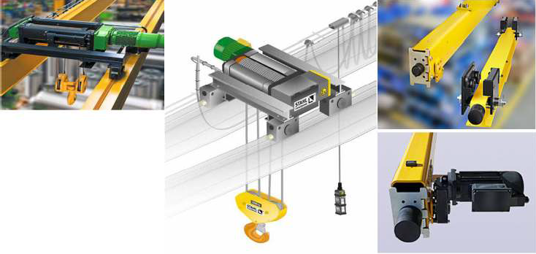
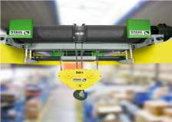
GERMAN make Crane components

Slide 21
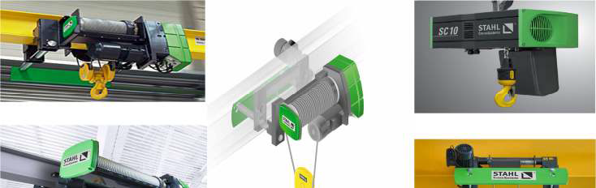
GERMAN make Wire Rope Hoists

