Slide 1

Trinity Solutions is dedicated to providing affordable alternatives to small community's infrastructure needs.

Slide 2
Wastewater and water treatment Systems
Sewage Treatment Plants
Industrial Effluent Treatment Plants
Water Treatment Plants

Slide 3
We develop innovative solutions
We offer customized solutions
We make all major equipment

Slide 4
What is Sewage Treatment ?
The organic material present in sewage is digested by aerobic bacteria and is converted in biomass and carbon dioxide.
Attached Growth and Suspended Growth are two types of aerobic biological treatment of sewage.

Slide 5
Sewage Treatment Plant
Moving Bed Biofilm Reactor(MBBR)technology
Combination of Suspended and Attached Growth Technologies
Containerized system=space saving
Capacity from 8000 gallons per day to 135,000 gallons per day
Simple operation
Meets EPA standards
Replacement for existing system or new system

Slide 6
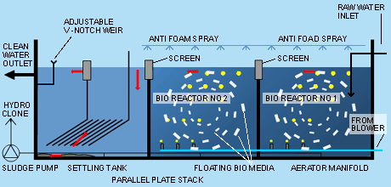

Slide 7
What is Sewage Quality?
BOD 250 – 400 mg/l
COD 600 – 800 mg/l
TSS 100 – 250 mg/l
OIL & GREASE 20 – 50 mg/l
T.D.S. Varies
Coliform Present

Slide 8
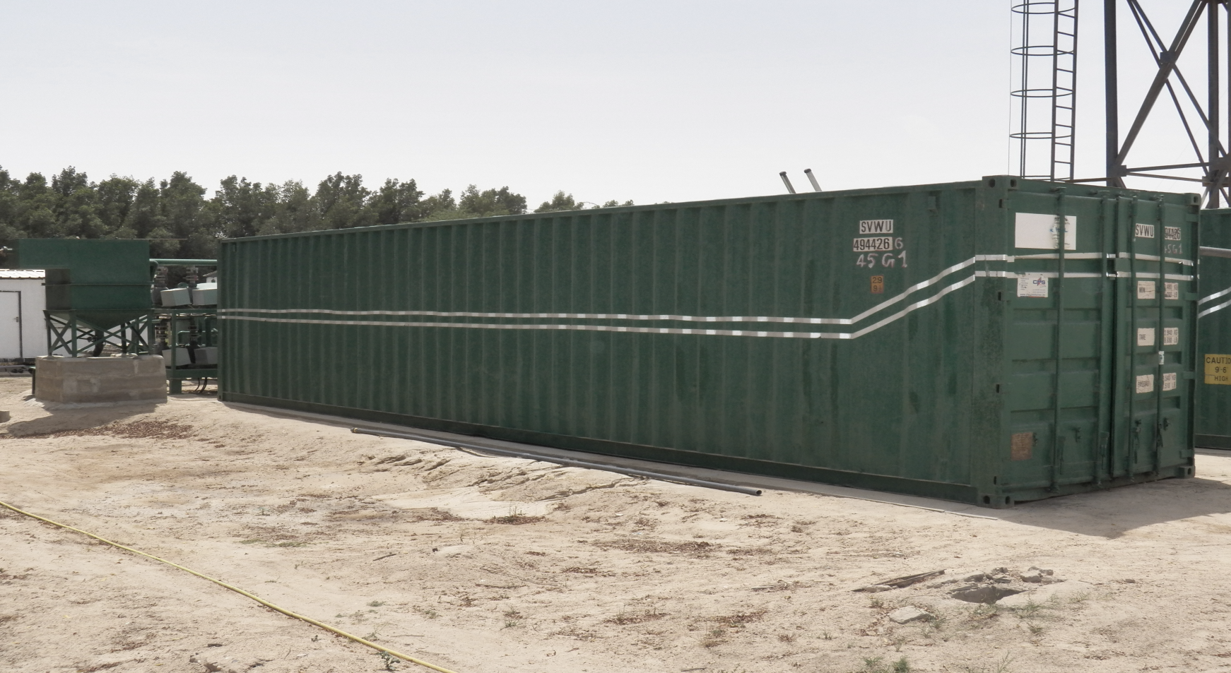
Containerized
Wastewater
Treatment Plant

Slide 9
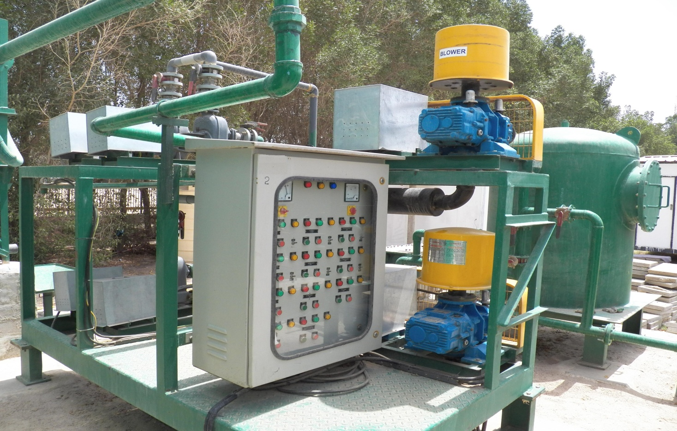
Containerized ETP Inside

Slide 10
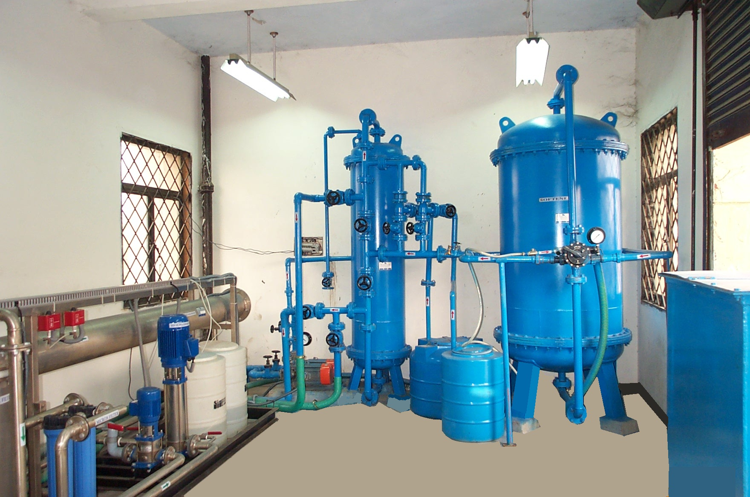
WATER TREATMENT PLANTS

Slide 11
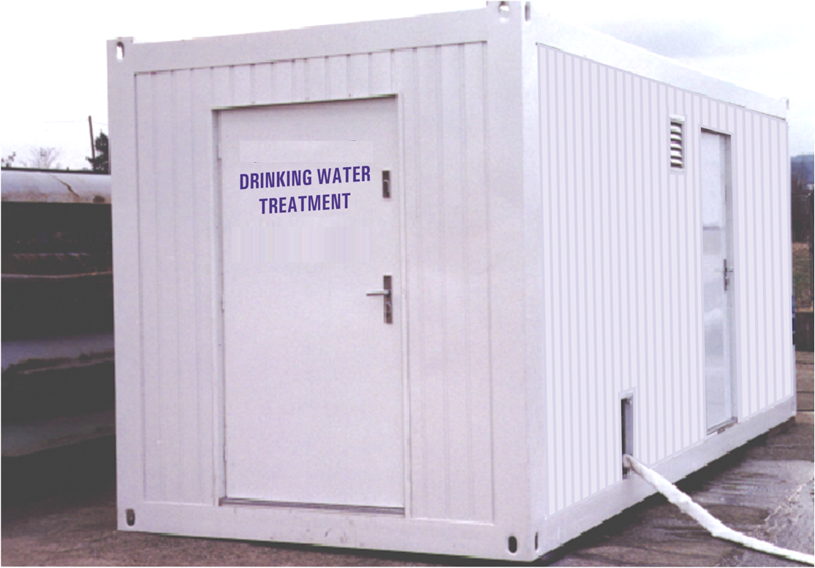
Mobile Drinking Water Treatment Plant

Slide 12
Why Trinity Solutions ?
It is compact treatment plant minimizing space requirements
Combination of Suspended & Attached Growth Technologies
Adjustable flow operation to meet varying requirements
Simple Operation
Easily expanded to meet future needs

